Slide 1
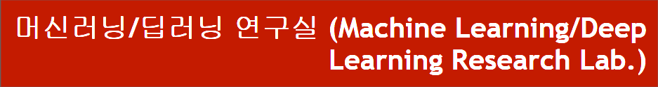
중기부과제 진행상황 보고
동서대학교 컴퓨터공학과
신지용,
강대기
2022.10.17
Notes:
1

Slide 2
목차
DARTS의 문제점
온도 계수의 특징
온도 계수 감쇠 적용 방법
실험 결과
Notes:
2

Slide 3
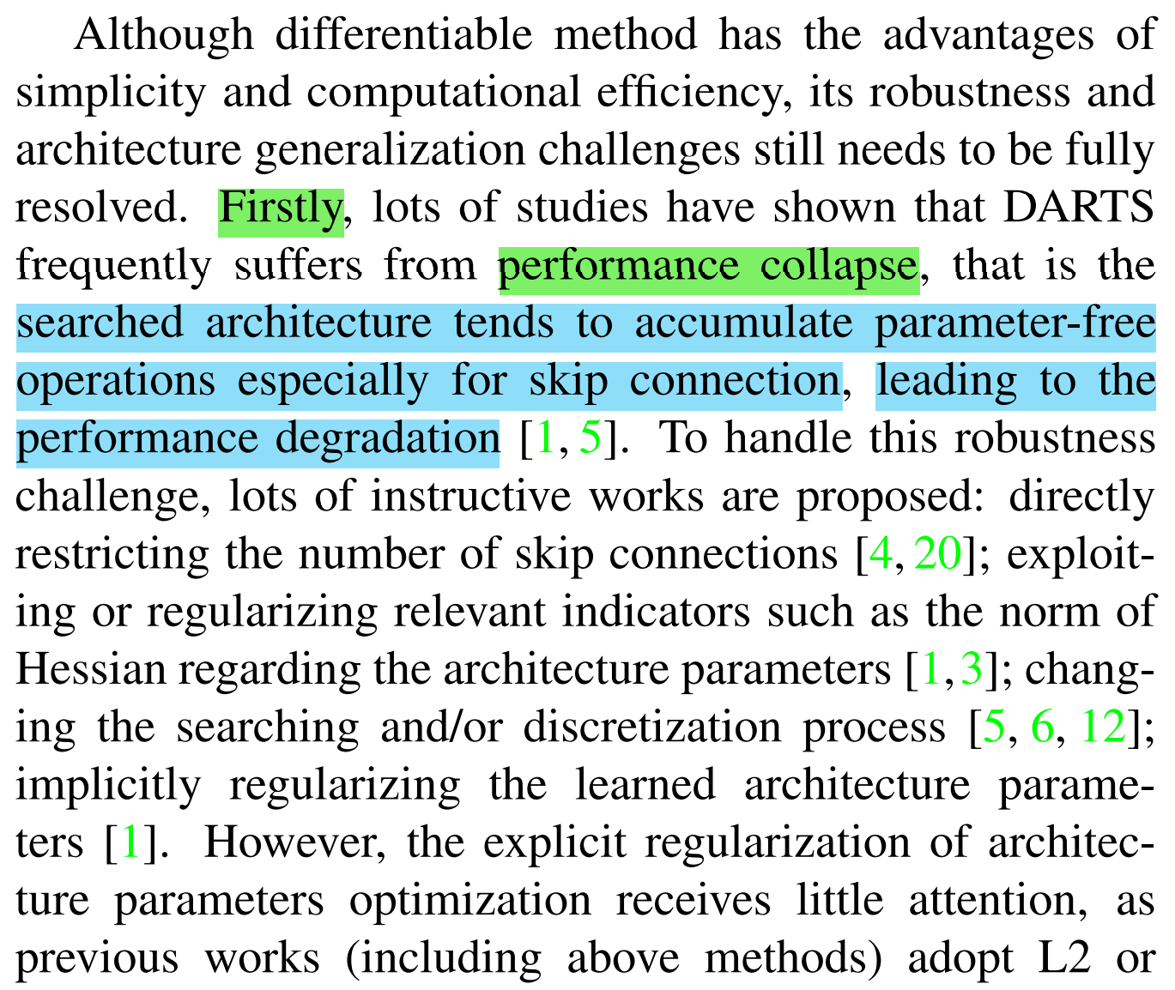
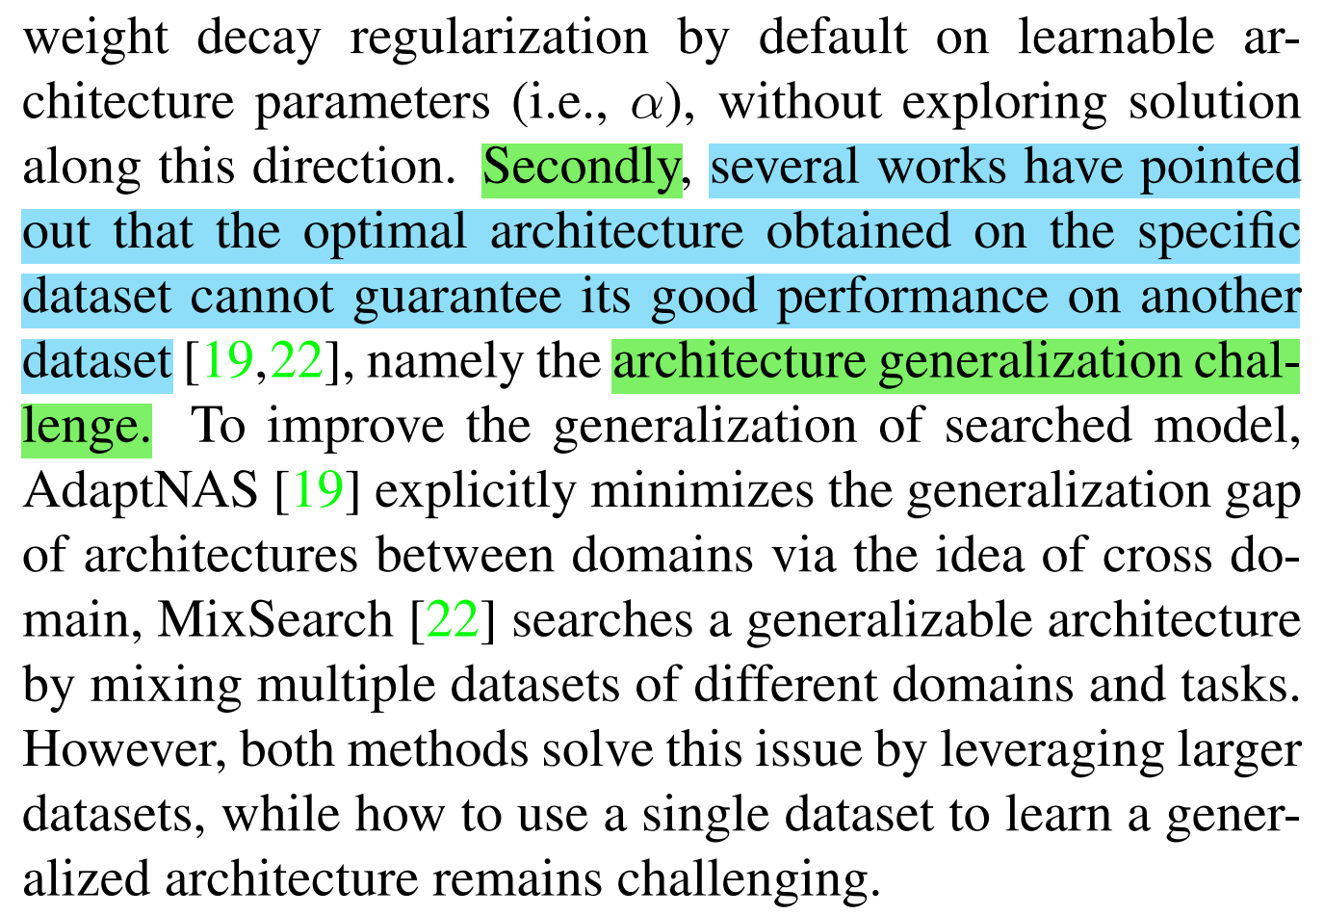
1. DARTS의 문제점
문제점
불일치 : 연속적으로 인코딩된 아키텍처와 실제 아키텍처의 이산성 간의 불일치.
성능 붕괴 : skip connection을 선택하려는 경향성을 보임.
아키텍처의 일반화 능력 : 특정 데이터의 서브셋에서 학습 후, 전체 데이터에서 테스트시 같은 성능을 보장할 수 없음.
Notes:
3

Slide 4
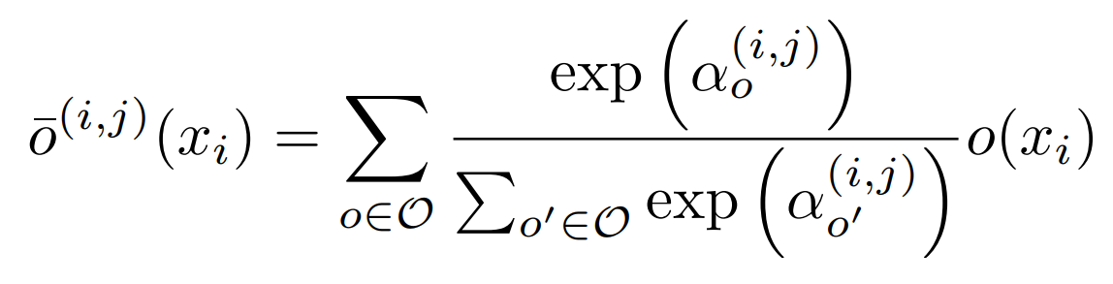
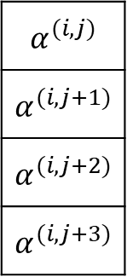
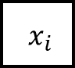
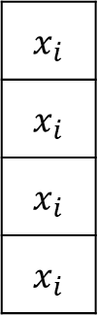
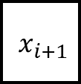
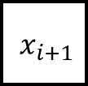
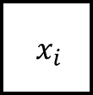
1. DARTS의 문제점
$${ x}_{i}$$
$${ x}_{i+1}$$
$${ x}_{i}$$
$$α^{(i,j)}$$
$$α^{(i,j+1)}$$
$$α^{(i,j+2)}$$
$$α^{(i,j+3)}$$
x
Convolution()
Pooling()
Skip()
Dilation()
$$x_{i}$$
$$x_{i}$$
$$x_{i}$$
$$x_{i}$$
x
+
$${ x}_{i+1}$$
x
x
$α$ * convolution($x_{i}$) + $α$ * pooling($x_{i}$) + $α$ * skip($x_{i}$) + $α$ * dilation($x_{i}$) = out
Notes:
4

Slide 5
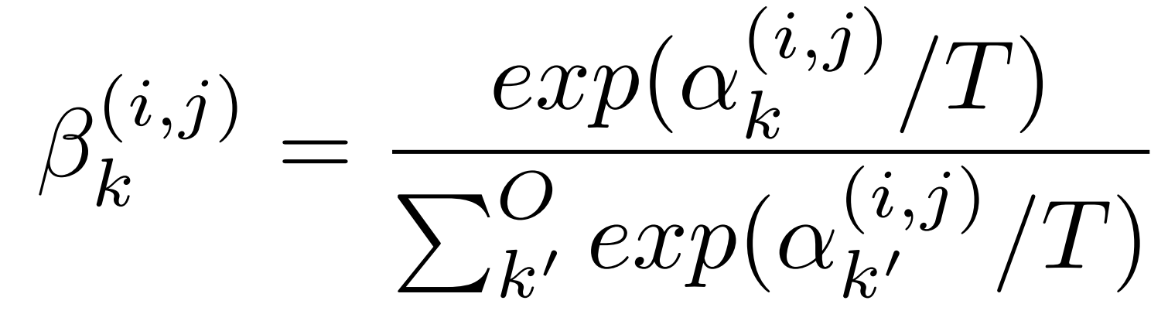
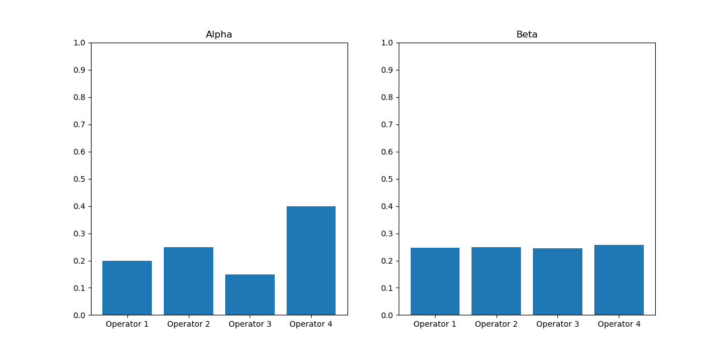
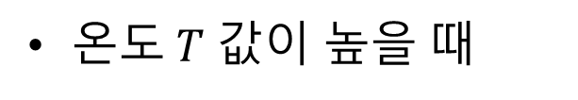
2. 온도 계수의 특징
온$도 T$ 값이 높을 때
- 높은 exploration, 낮은 exploitation
Notes:
5

Slide 6
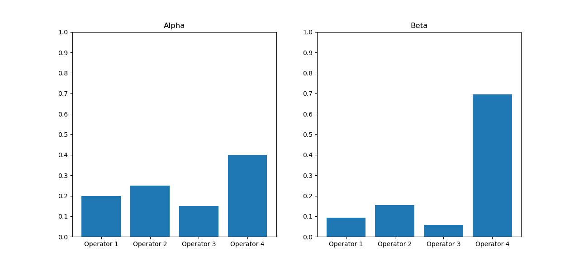
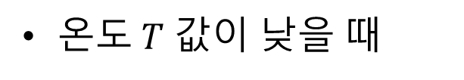
2. 온도 계수의 특징
온$도 T$ 값이 낮을 때
- 높은 exploitation, 낮은 exploration
Notes:
6

Slide 7
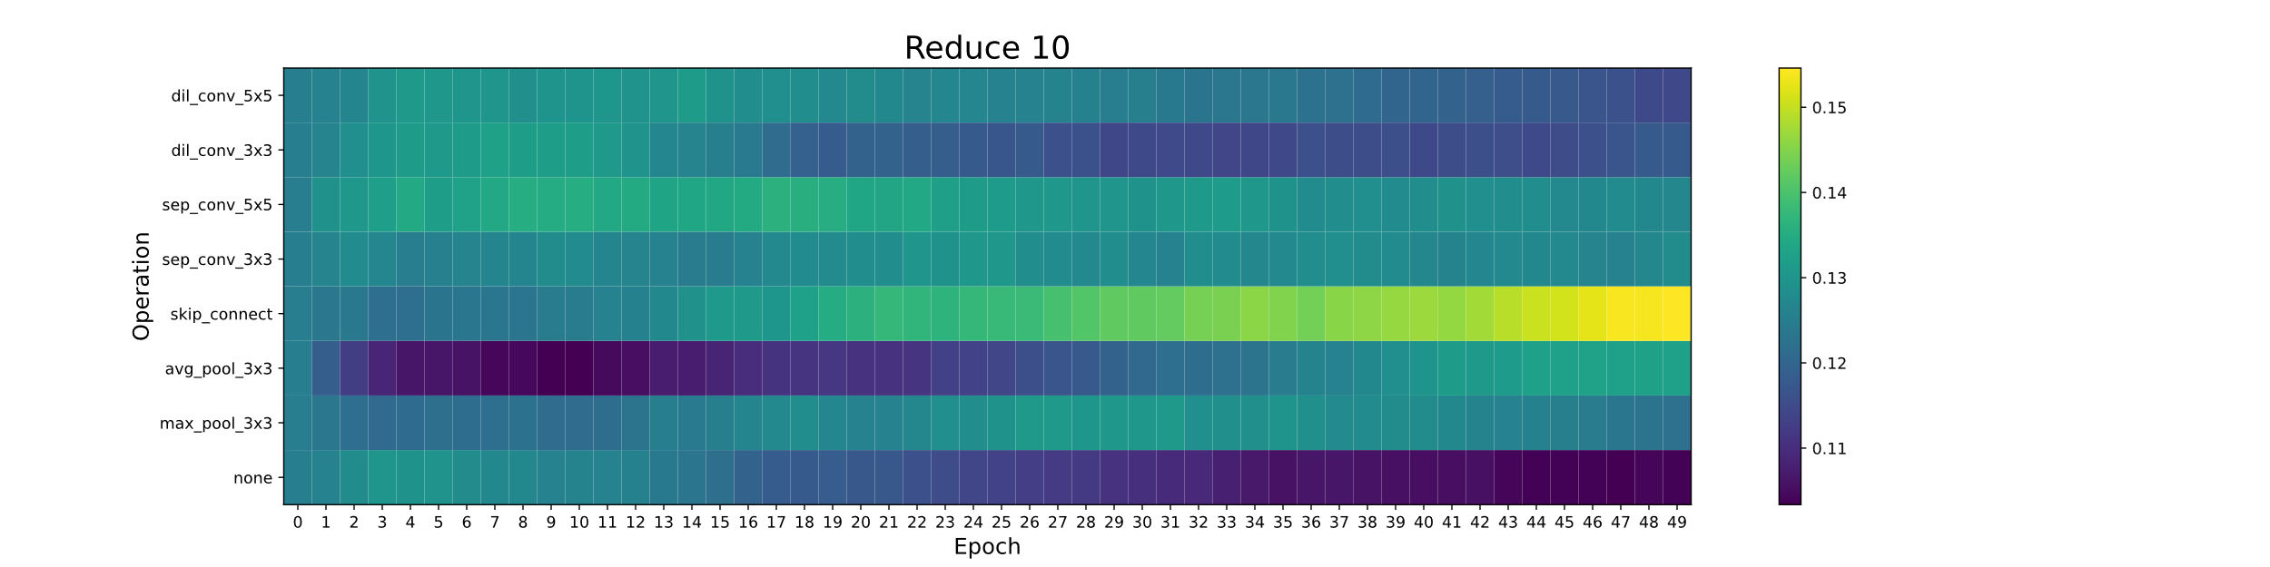
2. 온도 계수의 특징
$${ x}_{i}$$
$${ x}_{i+1}$$
가정
- 최종 선택과 DARTS의 weighted sum 간에 불일치 발생.
- Skip connection과 알파 값이 곱해지면서 선형성을 띔.
해결 방법
소프트맥스 함수의 입력값을 조정. (exploration/exploitation)
경쟁하는 연산자의 수를 줄인다. (Skip connection의 비중을 높여 선형 연산자가 선택되지 않게 한다.)
Notes:
7

Slide 8
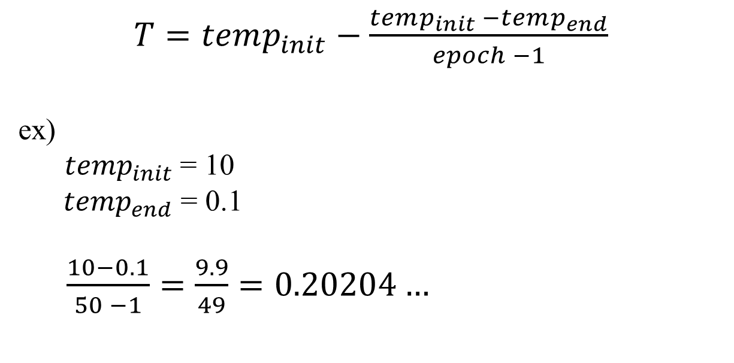
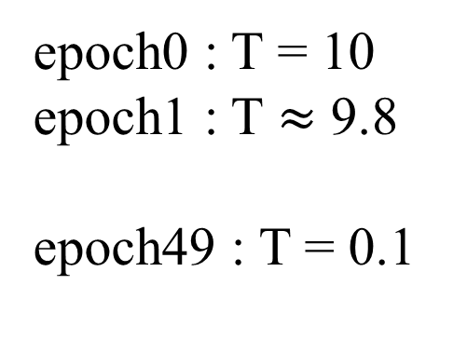
3. 온도 계수 감쇠 적용 방법
$T=temp_{init}−\frac{temp_{init} −temp_{end}}{epoch −1}$
ex)
$temp_{init}$= 10
$temp_{end}$ = 0.1
$\frac{10−0.1}{50 −1}=\frac{9.9}{49}=0.20204…$
epoch0 : T = 10
epoch1 : T $≈$ 9.8
epoch49 : T = 0.1
Notes:
8

Slide 9
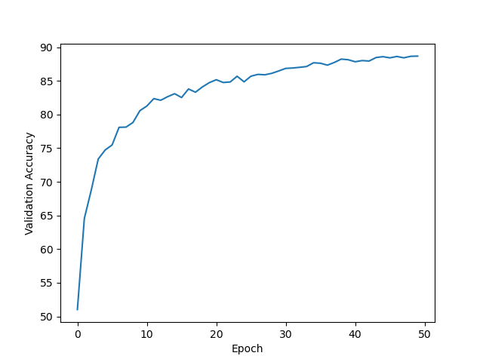
3. 온도 계수 감쇠 적용 방법
T
Notes:
9

Slide 10
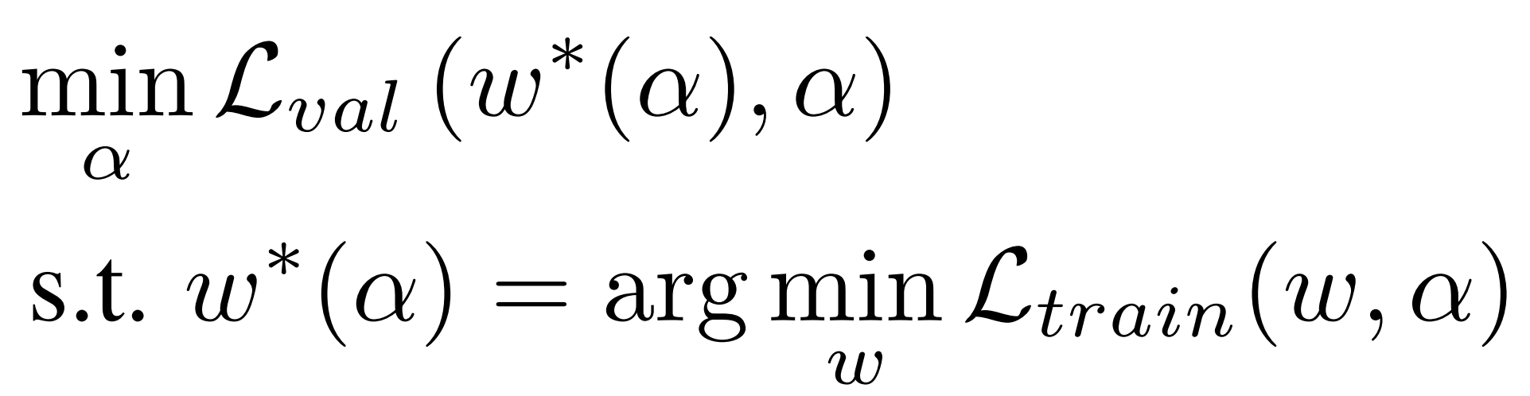
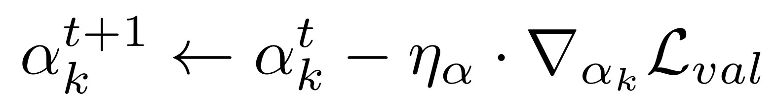
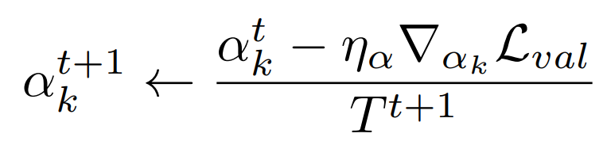
3. 온도 계수 감쇠 적용 방법
Optimization function of DARTS
How the alpha updated
$k$ : 간선 번호
Temperature Annealing
Notes:
10

Slide 11
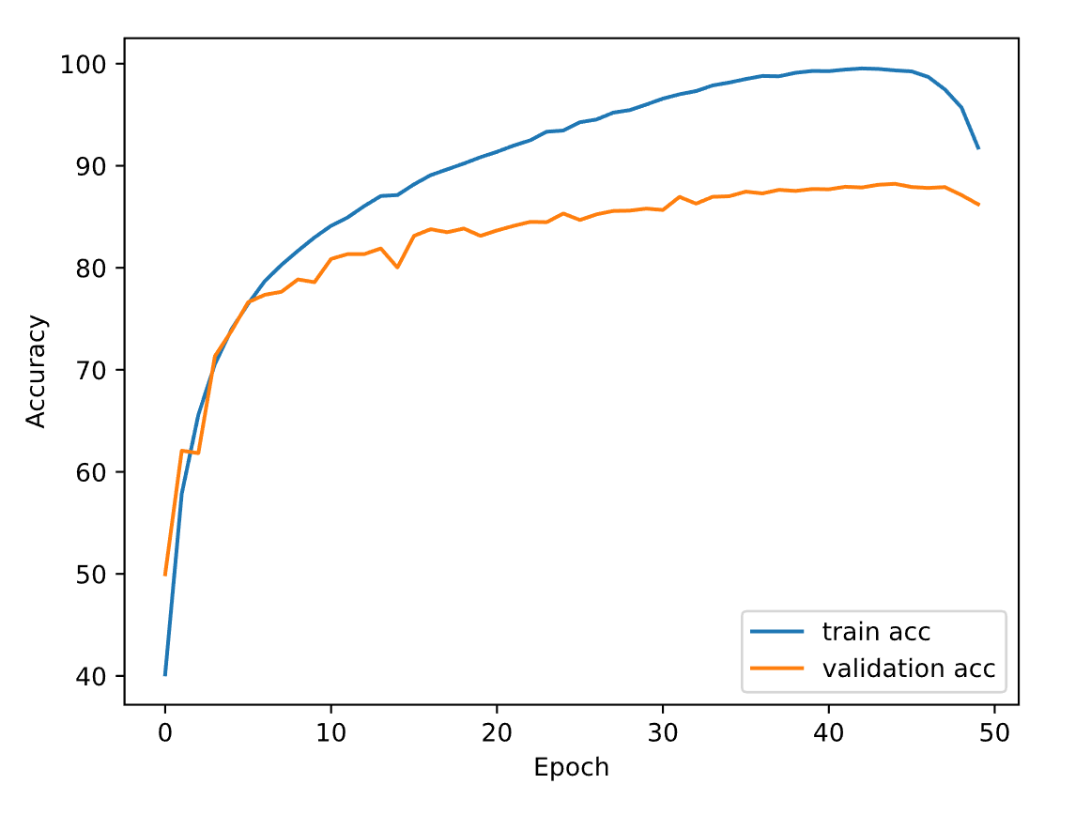
4. 실험 결과
검색 페이즈의 정확도
가장 높은 검증 정확도
44
49
Notes:
11

Slide 12
4. 실험 결과
Genotypes
Epoch 44
Epoch 50
Normal cell=
[('sep_conv_3x3', 1), ('sep_conv_5x5', 0), ('skip_connect', 0), ('sep_conv_3x3', 1), ('sep_conv_3x3', 1), ('skip_connect', 0), ('skip_connect', 0), ('sep_conv_3x3', 2)]
Reduce cell=
[('max_pool_3x3', 0), ('max_pool_3x3', 1), ('max_pool_3x3', 0), ('dil_conv_3x3', 1), ('max_pool_3x3', 0), ('skip_connect', 3), ('skip_connect', 3), ('avg_pool_3x3', 0)]
Normal cell=
[('skip_connect', 0), ('sep_conv_3x3', 1), ('skip_connect', 1), ('sep_conv_5x5', 0), ('skip_connect', 2), ('max_pool_3x3', 1), ('max_pool_3x3', 0), ('max_pool_3x3', 1)],
Reduce cell=
[('sep_conv_5x5', 0), ('sep_conv_5x5', 1), ('skip_connect', 2), ('avg_pool_3x3', 0), ('skip_connect', 2), ('sep_conv_3x3', 1), ('skip_connect', 2), ('skip_connect', 3)]
Notes:
12

Slide 13
4. 실험 결과
Epoch | Val acc (%) | Train acc (%) | Total # of skip connection
40 | 87.692 | 99.272 | 5
41 | 87.940 | 99.428 | 5
42 | 87.872 | 99.536 | 5
43 | 88.140 | 99.488 | 5
44 | 88.228 | 99.344 | 5
45 | 87.916 | 99.248 | 6
46 | 87.824 | 98.700 | 6
47 | 87.908 | 97.476 | 8
48 | 87.124 | 95.708 | 8
49 | 86.224 | 91.776 | 8
50 | - | - | 7
Notes:
13

Slide 14
4. 실험 결과
Genotype | Test acc (%)
DARTS_V2 | 97.24
TD-DARTS_60_50 | 96.94
TD-DARTS_60_44 | 97.37
Notes:
14

Slide 15
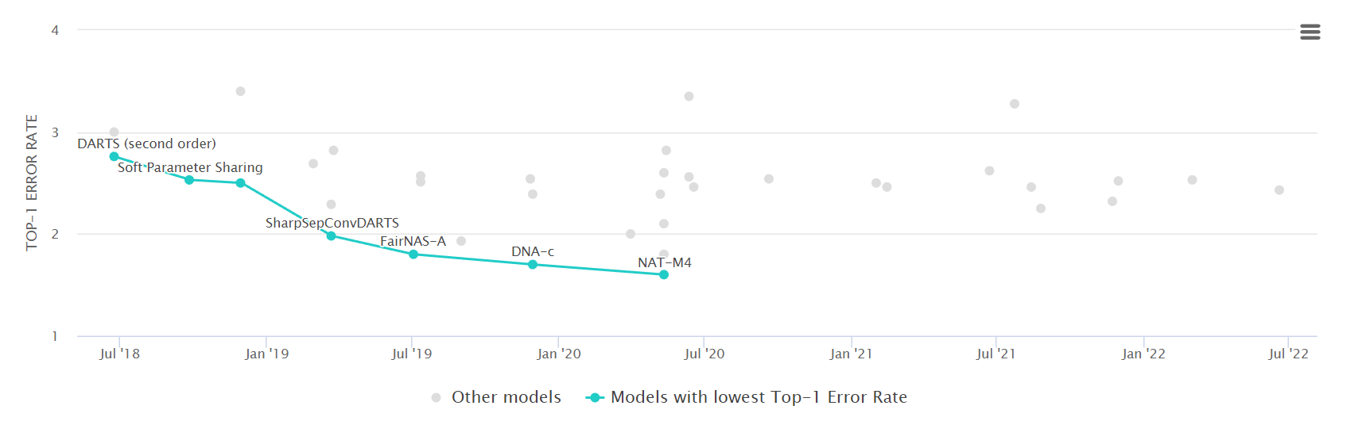
4. 실험 결과
CIFAR-10 에 적용된 다른 NAS 알고리즘들과의 비교
TD-DARTS
Notes:
15

Slide 16
참고 문헌
DARTS: Differentiable Architecture Search https://arxiv.org/abs/1806.09055
Differentiable Architecture Search with Ensemble Gumbel-Softmax https://arxiv.org/abs/1905.01786
Categorical Reparameterization with Gumbel-Softmax https://arxiv.org/abs/1611.01144
Fair DARTS: Eliminating Unfair Advantages in Differentiable Architecture Search https://arxiv.org/abs/1911.12126
β-DARTS: Beta-Decay Regularization for Differentiable Architecture Search https://arxiv.org/abs/2203.01665
Notes:
16

Slide 17
Thank you
Q & A
17
Notes:
-
The training of procedure for is to maximize the probability of D making a mistake. This framework corresponds to a minimax two-player game.
In the space of arbitrary functions G and D, a unique solution exists, with G recovering the training data distribution and D equal to ½ everywhere.
17

Slide 18
4. 결론
Optimization gap
discrepancies between the continuous architecture encoding and the derived discrete architecture.
This could be alleviated by annealing the softmax temperature (with a suitable schedule) to enforce one-hot selection [DARTS].
By rescaling alpha with a small temperature, could decrease discrepancy.
Exploration / Exploitation
By decaying the temperature from 10 to 0.1, we could explore more at the beginning of the search phase.
Yet, the increasing skip connection problem still remains.
Notes:
18

Slide 19
4. Result
DARTS VS TD-DARTS
대충 search acc graph 비교 표
Search 인지 train 인지 기억 잘 안남
여하튼 학습 더 빠름
Train 이면 여기 올릴 필요 없을듯
Notes:
19

Slide 20
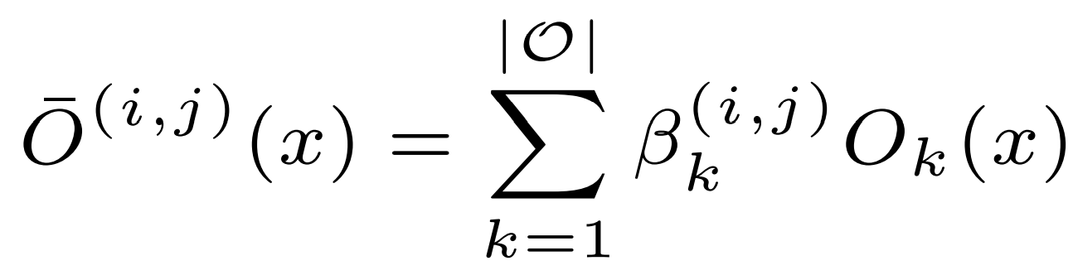
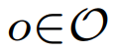
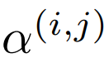
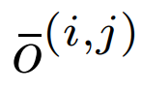
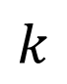
2. Temperature Decay
Operation pool = [Convolution,
Pooling,
Skip,
Dilation]
$${ x}_{i}$$
$${ x}_{i+1}$$
$$k$$
: Example of a set O : {Convolution, Pooling, Skip, Dilation}
: Weights of operations (Vector)
: Mixed operation
Notes:
20

Slide 21
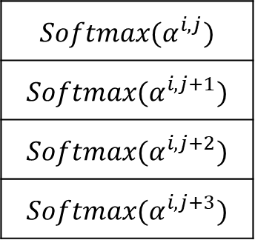
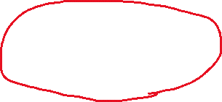
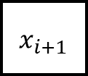
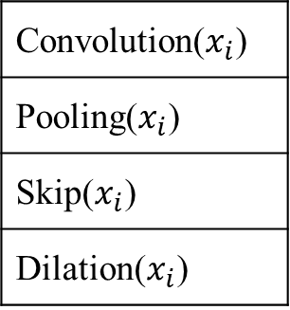
1. DARTS
$${ x}_{i}$$
$${ x}_{i+1}$$
$${Softmax(α}^{i,j})$$
$${Softmax(α}^{i,j+1})$$
$${Softmax(α}^{i,j+2})$$
$${Softmax(α}^{i,j+3})$$
x
Convolution($x_{i}$)
Pooling($x_{i}$)
Skip($x_{i}$)
Dilation($x_{i}$)
x
+
$${ x}_{i+1}$$
x
x
$β$ · Convolution($x_{i}$) + $β$· Pooling($x_{i}$) + $β$· Skip($x_{i}$) + $β$· Dilation($x_{i}$) = out
Notes:
21

Slide 22

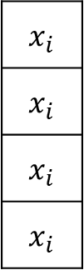
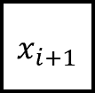
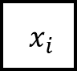
1. DARTS
$${ x}_{i}$$
$${ x}_{i+1}$$
$$x_{i}$$
$$x_{i}$$
$$x_{i}$$
$$x_{i}$$
Convolution()
Pooling()
Skip()
Dilation()
$${ x}_{i}$$
+
$${ x}_{i+1}$$
convolution($x_{i}$) + pooling($x_{i}$) + skip($x_{i}$) + dilation($x_{i}$) = out
Notes:
22

Slide 23
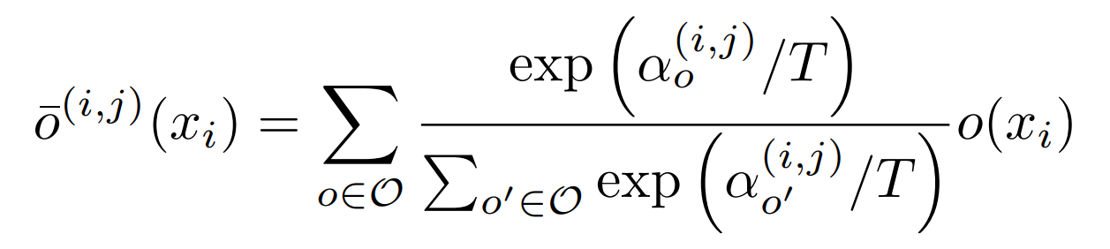
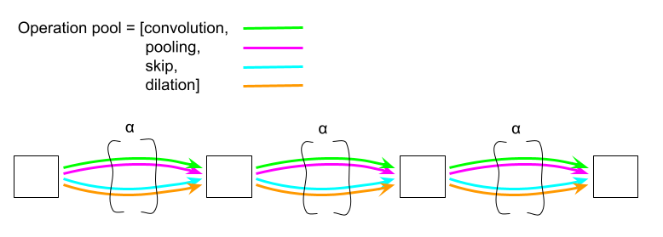
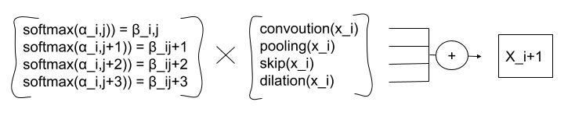
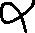
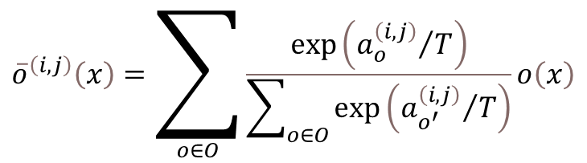
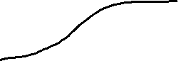
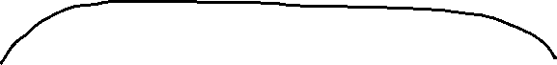
3. Idea
Mixed operation with Temperature Anealing
$${\overline{o}}^{\left(i,j\right)}\left(x\right)=\sum_{o∈O}{\frac{\exp\left({a_{o}^{\left(i,j\right)}}/T\right)}{\sum_{o∈O}{\exp\left({a_{o^{′}}^{\left(i,j\right)}}/T\right)}}o\left(x\right)}$$
Notes:
23

Slide 24
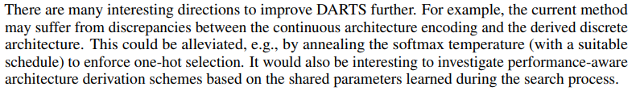
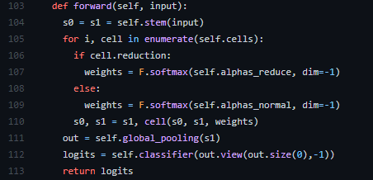
5. Research Progress
Notes:
24

Slide 25
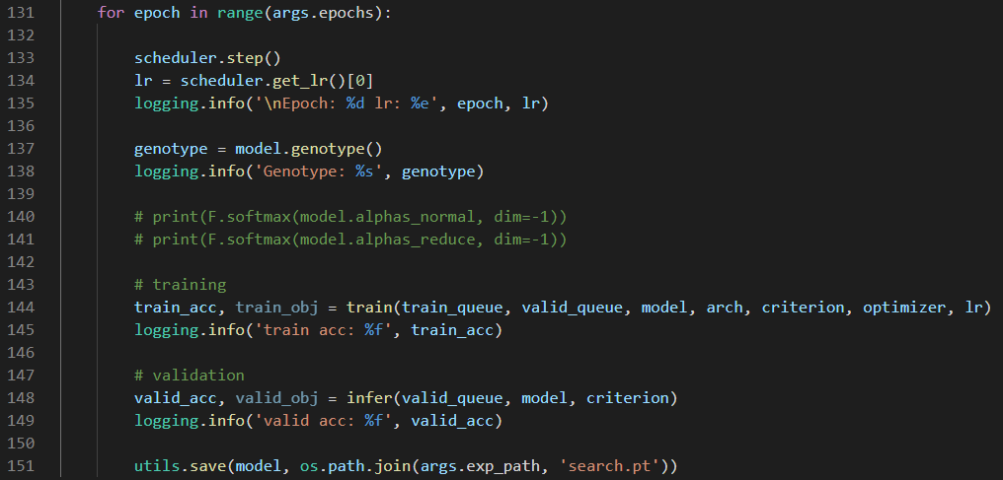
3. Code Analysis
train_search.py
Notes:
25

Slide 26
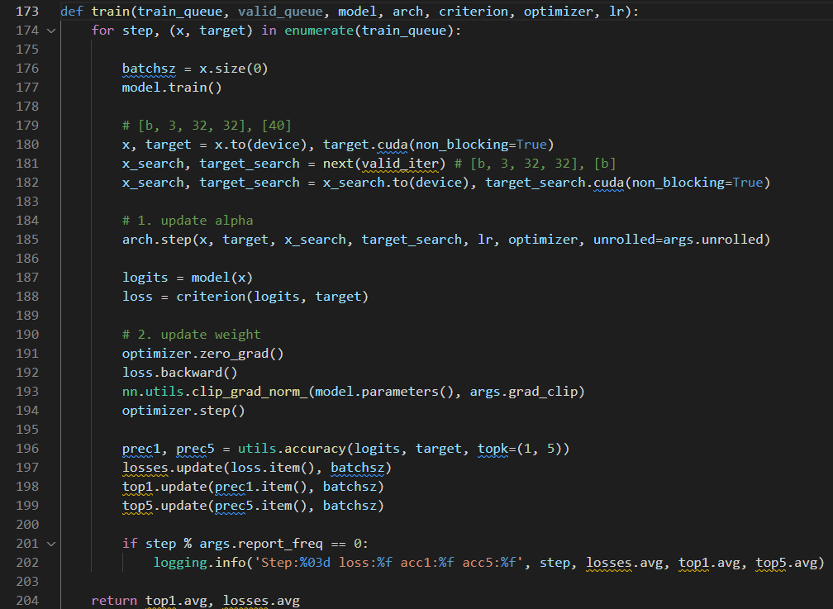
3. Code Analysis
train_search.py
Notes:
26

Slide 27
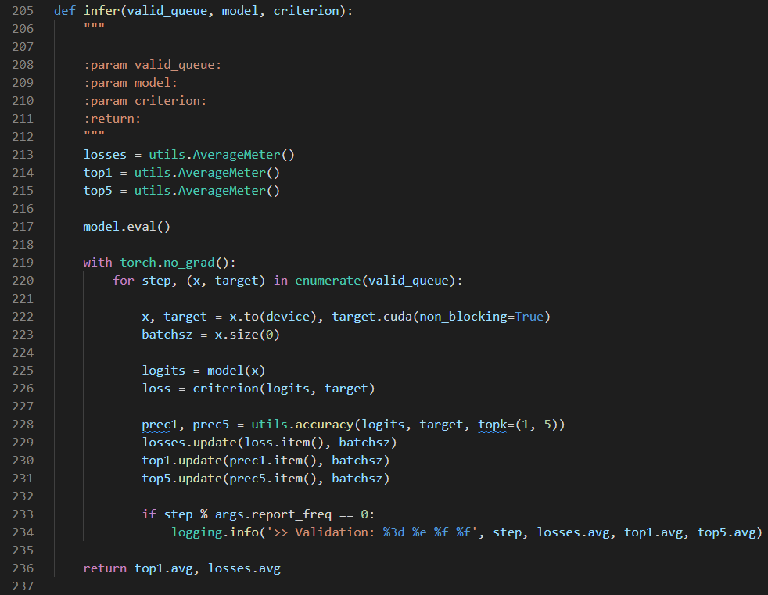
3. Code Analysis
train_search.py
Notes:
27

Slide 28
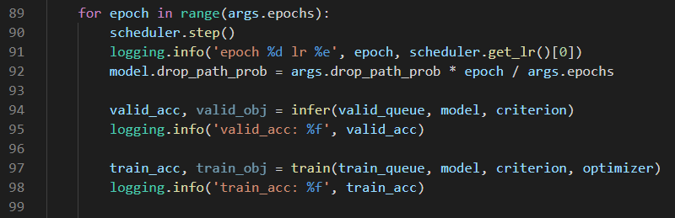
3. Code Analysis
train.py
Notes:
28

Slide 29
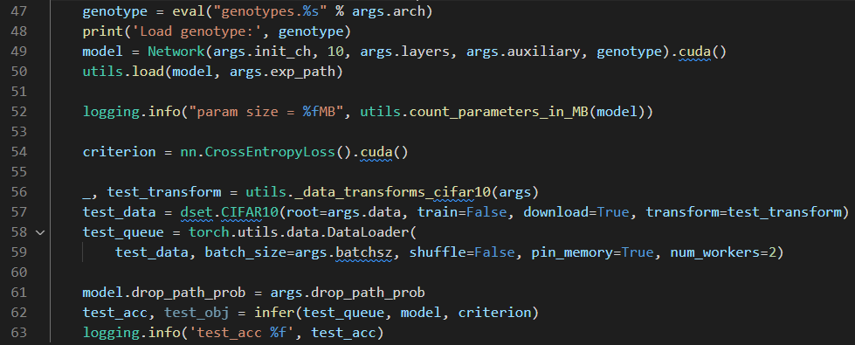
3. Code Analysis
test.py
Notes:
29

Slide 30

3. Code Analysis
Genotype
Notes:
30

Slide 31

3. Code Analysis
Operators
Notes:
31

Slide 32


3. Code Analysis
Notes:
32

Slide 33

3. Code Analysis
Notes:
33

Slide 34


4. Problems Discussed
Common case)
After 50th epoch
After 50th epoch
Notes:
34

Slide 35

6. Conclusion and Discussion
이러한 결과는 기존의 Neural Architecture Search 문제를 제기하고 해결한
NAS, ENAS등의 유명 논문들이 채용한 문제 세팅을 DARTS에서도 그대로 채용하였기 때문에 softmax만으로는 충분한 continuous relaxation을 이끌어내지 못했기 때문이라고 생각함. 8가지 operation이 아닌, 10만개 정도의 operation이 있다면 어느정도 충분한 relaxation이 가능할 것으로 예상되나, 이는 목적에 맞지 않는 불필요하게 너무 많은 operation일 수 있다.
Notes:
35

Slide 36



1. Summary
Approximation that significantly reduces search cost
Notes:
36

Slide 37

1. Summary
As a result, it outperforms other SOTA algorithms
Notes:
37

Slide 38

2. Search space
Directed Acyclic Graph
Notes:
38

Slide 39



2. Search space
Directed Acyclic Graph
x(i) : input
x(j) : output
o(i,j) : operation (transforms x(i))
Notes:
39

Slide 40



3. Continuous relaxation and optimization
The task of architecture search then reduces to learning a set of continuous variables α = { α (i,j) }
At the end of the search, replace
with
Notes:
40

Slide 41

4. Results
The example shows that a suitable choice of ξ helps to converge to a better local optimum.
Notes:
41

Slide 42



4. Conclusion and Discussion
Notes:
42

Slide 43


3. Continuous relaxation and optimization
Algorithm
: Learning rate for a step of inner optimization
Notes:
43

Slide 44
5. Conclusion
Optimization gap
discrepancies between the continuous architecture encoding and the derived discrete architecture.
This could be alleviated by annealing the softmax temperature (with a suitable schedule) to enforce one-hot selection.
Performance-aware architecture derivation schemes based on the shared parameters learned during the search process.
Notes:
44

Slide 45

4. Results
Transfer learning with DARTS
Notes:
45

Slide 46

4. Results
Gumbel-Softmax
Notes:
46

Slide 47

4. Results
Gumbel-Softmax
Notes:
47

Slide 48






3. Related Work
Mixed operation with Temperature Annealing
$$α_{k^{′}}$$
0.48
0.17
0.07
0.28
x
Convolution($x_{i}$)
Pooling($x_{i}$)
Skip($x_{i}$)
Dilation($x_{i}$)
x
+
$${ x}_{i+1}$$
$$L_{val}(L_{train}\left(w^{∗}\right), α)$$
x
x
Notes:
48

Slide 49

1. Continuous Relaxation
Notes:
49

Slide 50

3. Related Work
Mixed operation with Temperature Annealing
$$α_{o^{′}}$$
0.48
0.17
0.07
0.28
x
Convolution($x_{i}$)
Pooling($x_{i}$)
Skip($x_{i}$)
Dilation($x_{i}$)
x
+
$${ x}_{i+1}$$
$$L_{val}(L_{train}\left(w^{∗}\right), α)$$
x
x
Notes:
50

Slide 51



4. Idea (1/2)
Decaying Temperature
First, more exploration with high temperature.
0.24
0.26
0.23
0.28
x
Convolution($x_{i}$)
Pooling($x_{i}$)
Skip($x_{i}$)
Dilation($x_{i}$)
x
+
$${ x}_{i+1}$$
x
x
Notes:
51

Slide 52
4. Idea (1/2)
Decaying Temperature
After then, more exploitation with low temperature.
0.1
0.1
0.1
0.7
x
Convolution($x_{i}$)
Pooling($x_{i}$)
Skip($x_{i}$)
Dilation($x_{i}$)
x
+
$${ x}_{i+1}$$
x
x
Notes:
52

Slide 53


2. Discussion
Notes:
53

Slide 54



1. Continuous Relaxation
: Example of a set O : {Convolution, Pooling, Skip, Dilation}
: Weights of operations (Vector)
: Mixed operation
Notes:
54

Slide 55









1. Continuous Relaxation
Operation pool = [Convolution,
Pooling,
Skip,
Dilation]
$${ x}_{i}$$
$${ x}_{i+1}$$
$${ x}_{i+2}$$
$${ x}_{i+3}$$
$$Softmax\left(α\right)=β$$
$${= x}_{i+1}$$
$i$ : $i$ th edge
$j$ : $j$ th operation in $i$ th edge
Notes:
55

Slide 56



1. Continuous Relaxation
$${ x}_{i}$$
$${ x}_{i+1}$$
$${ x}_{i}$$
Convolution()
Pooling()
Skip()
Dilation()
$$x_{i}$$
$$x_{i}$$
$$x_{i}$$
$$x_{i}$$
+
$${ x}_{i+1}$$
Convolution($x_{i}$) + Pooling($x_{i}$) + Skip($x_{i}$) + Dilation($x_{i}$) = out
Notes:
56

Slide 57



1. Continuous Relaxation
$${ x}_{i}$$
$${ x}_{i+1}$$
Convolution($x_{i}$)
Pooling($x_{i}$)
Skip($x_{i}$)
Dilation($x_{i}$)
+
$${ x}_{i+1}$$
Convolution($x_{i}$) + Pooling($x_{i}$) + Skip($x_{i}$) + Dilation($x_{i}$) = out
Notes:
57

Slide 58




1. Continuous Relaxation
$${ x}_{i}$$
$${ x}_{i+1}$$
$$α^{(i,j)}$$
$$α^{(i,j+1)}$$
$$α^{(i,j+2)}$$
$$α^{(i,j+3)}$$
x
Convolution($x_{i}$)
Pooling($x_{i}$)
Skip($x_{i}$)
Dilation($x_{i}$)
x
+
$${ x}_{i+1}$$
x
x
$α$ · Convolution($x_{i}$) + $α$ · Pooling($x_{i}$) + $α$ · Skip($x_{i}$) + $α$ · Dilation($x_{i}$) = out
Notes:
58

Slide 59





1. Continuous Relaxation
$${ x}_{i}$$
$${ x}_{i+1}$$
$$α^{(i,j)}$$
$$α^{(i,j+1)}$$
$$α^{(i,j+2)}$$
$$α^{(i,j+3)}$$
x
Convolution($x_{i}$)
Pooling($x_{i}$)
Skip($x_{i}$)
Dilation($x_{i}$)
x
$$Softmax( )$$
+
$${ x}_{i+1}$$
x
x
$α$ · Convolution($x_{i}$) + $α$ · Pooling($x_{i}$) + $α$ · Skip($x_{i}$) + $α$ · Dilation($x_{i}$) = out
Notes:
59

Slide 60




1. Continuous Relaxation
$${ x}_{i}$$
$${ x}_{i+1}$$
$$β_{conv}$$
$$β_{pool}$$
$$β_{skip}$$
$$β_{dil}$$
x
Convolution($x_{i}$)
Pooling($x_{i}$)
Skip($x_{i}$)
Dilation($x_{i}$)
x
+
$${ x}_{i+1}$$
x
x
$β$ · Convolution($x_{i}$) + $β$· Pooling($x_{i}$) + $β$· Skip($x_{i}$) + $β$· Dilation($x_{i}$) = out
Notes:
60

Slide 61



1. Continuous Relaxation
$${ x}_{i}$$
$${ x}_{i+1}$$
$$α^{(i,j)}$$
$$α^{(i,j+1)}$$
$$α^{(i,j+2)}$$
$$α^{(i,j+3)}$$
$$Softmax( )$$
Notes:
61

Slide 62


1. Continuous Relaxation
$${ x}_{i}$$
$${ x}_{i+1}$$
$$α_{conv}$$
$$α_{pool}$$
$$α_{skip}$$
$$α_{dil}$$
$$Softmax( )$$
Notes:
62

Slide 63




1. Continuous Relaxation
$${ x}_{i}$$
$${ x}_{i+1}$$
$$α$$
$$β$$
2
1
0.1
1.5
0.47
0.17
0.07
0.28
$$Softmax( )$$
Notes:
63

Slide 64



1. Continuous Relaxation
$${ x}_{i}$$
$${ x}_{i+1}$$
0.47
0.17
0.07
0.28
x
Convolution($x_{i}$)
Pooling($x_{i}$)
Skip($x_{i}$)
Dilation($x_{i}$)
x
+
$${ x}_{i+1}$$
x
x
Notes:
64

Slide 65












1. Continuous Relaxation
Back-propagation
$${ x}_{i}$$
$${ x}_{i+1}$$
$${ x}_{i+2}$$
$${ x}_{i+3}$$
$$L_{val}(L_{train}\left(w^{∗}\right), α)$$
Notes:
65

Slide 66



1. Continuous Relaxation
$${ x}_{i}$$
$${ x}_{i+1}$$
0.48
0.17
0.07
0.28
x
Convolution($x_{i}$)
Pooling($x_{i}$)
Skip($x_{i}$)
Dilation($x_{i}$)
x
+
$${ x}_{i+1}$$
$$L_{val}(L_{train}\left(w^{∗}\right), α)$$
x
x
Notes:
66

Slide 67


1. Continuous Relaxation
$${ x}_{i}$$
$${ x}_{i+1}$$
Search end
0.1
0.2
0.4
0.3
x
Convolution($x_{i}$)
Pooling($x_{i}$)
Skip($x_{i}$)
Dilation($x_{i}$)
x
+
$${ x}_{i+1}$$
x
x
Notes:
67

Slide 68

1. Continuous Relaxation
$${ x}_{i}$$
$${ x}_{i+1}$$
One-hot encoding
0
0
1
0
x
Convolution($x_{i}$)
Pooling($x_{i}$)
Skip($x_{i}$)
Dilation($x_{i}$)
x
+
$${ x}_{i+1}$$
x
x
Notes:
68

Slide 69


1. Continuous Relaxation
$${ x}_{i}$$
$${ x}_{i+1}$$
Skip($x_{i}$)
$${ x}_{i+1}$$
Notes:
69

Slide 70




3. Related Work
DARTS’s Mixed operation
Gumbel-Softmax DARTS
Fair DARTS
Notes:
70

Slide 71
1. Continuous Relaxation
: Example of a set O : {Convolution, Pooling, Skip, Dilation}
: Weights of operations (Vector)
: Mixed operation
Notes:
71

Slide 72






4. Idea (2/2)
1 ~ 100 epoch
0.25
0.25
0.25
0.25
x
Convolution($x_{i}$)
Pooling($x_{i}$)
Skip($x_{i}$)
Dilation($x_{i}$)
x
+
$${ x}_{i+1}$$
$$L_{val}(L_{train}\left(w^{∗}\right), α)$$
x
x
After 100 epoch
0.2
0
0.4
0
x
Convolution($x_{i}$)
Pooling($x_{i}$)
Skip($x_{i}$)
Dilation($x_{i}$)
x
+
$${ x}_{i+1}$$
$$L_{val}(L_{train}\left(w^{∗}\right), α)$$
x
x
Notes:
72

Slide 73






4. Idea (2/2)
101 ~ 200 epoch
0.5
0.5
x
Skip($x_{i}$)
Convolution($x_{i}$)
+
$${ x}_{i+1}$$
$$L_{val}(L_{train}\left(w^{∗}\right), α)$$
x
Search end
0.1
0.9
x
Skip($x_{i}$)
Convolution($x_{i}$)
+
$${ x}_{i+1}$$
$$L_{val}(L_{train}\left(w^{∗}\right), α)$$
x
Notes:
73

